Slide 1
YouTube Sentiment Analysis
By Andie Donovan, Shon Inouye, and Matthew Peterschmidt

Slide 2
Agenda
An overview of what we are going to talk about today
1
2
3
4
5
Introduction
Results
Live Demo
Conclusions
Data Modeling Steps
Notes:
Matthew

Slide 3

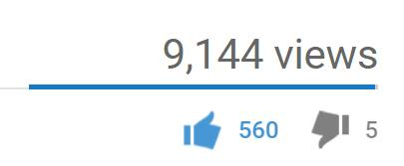
Introduction
Basic overview of NLP and our business problem
Analysis of YouTube comments
Machine Learning in Python
Sentiment Analysis: Determining emotions and attitudes from text
Insights from social data are extremely valuable
Notes:
Shon:
Our project is on sentiment analysis of youtube comments. As many of you know, youtube is a popular video sharing website with 5 billion videos being watched every day. And on each of those videos, users are allowed to leave comments. What we wanted to do is perform sentiment analysis on these youtube comments in Python. Sentiment analysis is the study of text to determine how people feel about certain topics. So basically, We wanted to Teach a machine how to understand human emotions in text.
This topic is extremely useful in social media, since it allows us to gain an overview of the wider public opinion behind certain topics. And these insights are extremely important and valuable to organizations across the world.
*** like dislike ratio
Despite the increased prominence of social media platforms and discussion forums, computer-based analysis of human language remains complex and elusive. Why? Words are hard to understand, even for humans. Sarcasm, double meanings, slang, copypasta, trolling, it can be a nightmare to sort through an entire comments section and get a comprehensive full view.

Slide 4
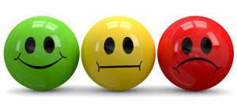


Goals
Why study YouTube comments?
Perform sentiment analysis
Positive, Negative, and Neutral
Create a user-friendly application
Notes:
Matthew
-talk about neutral (broad group for a lot of things)
-talk about like dislike options but how it can sometimes not be a good indicator
-example logan paul video
-using Natural Language Processing + Machine Learning
-that helps content providers analyze the comment section as a whole in specific Youtube videos
-convey audience sentiment and video reception to content creators.

Slide 5
Data Modeling Steps
Steps in the data science process
Data Collection
Choosing pre-labeled social media data sets and extracting comments from select videos from the API
05
Data Visualizations
Plotting graphs, creating word clouds, and building a dashboard to showcase results
01
04
Making Predictions
Using the models to make predictions on the classification of the comments based on fitted models
Data Cleaning and NLP
Cleaning up the comments and performing natural language processing to reduce noise and redundancy in the data
02
03
Data Transformation and Modeling
Transforming the textual into numeric format and fitting machine learning algorithms on labeled training data
Notes:
Shon

Slide 6
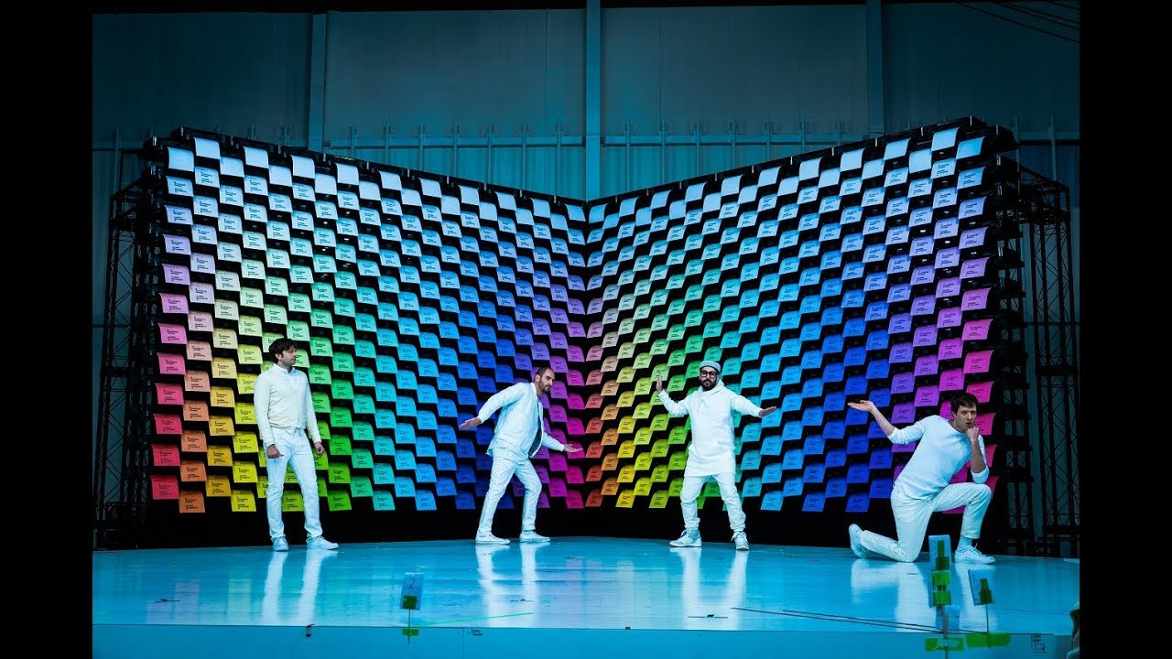

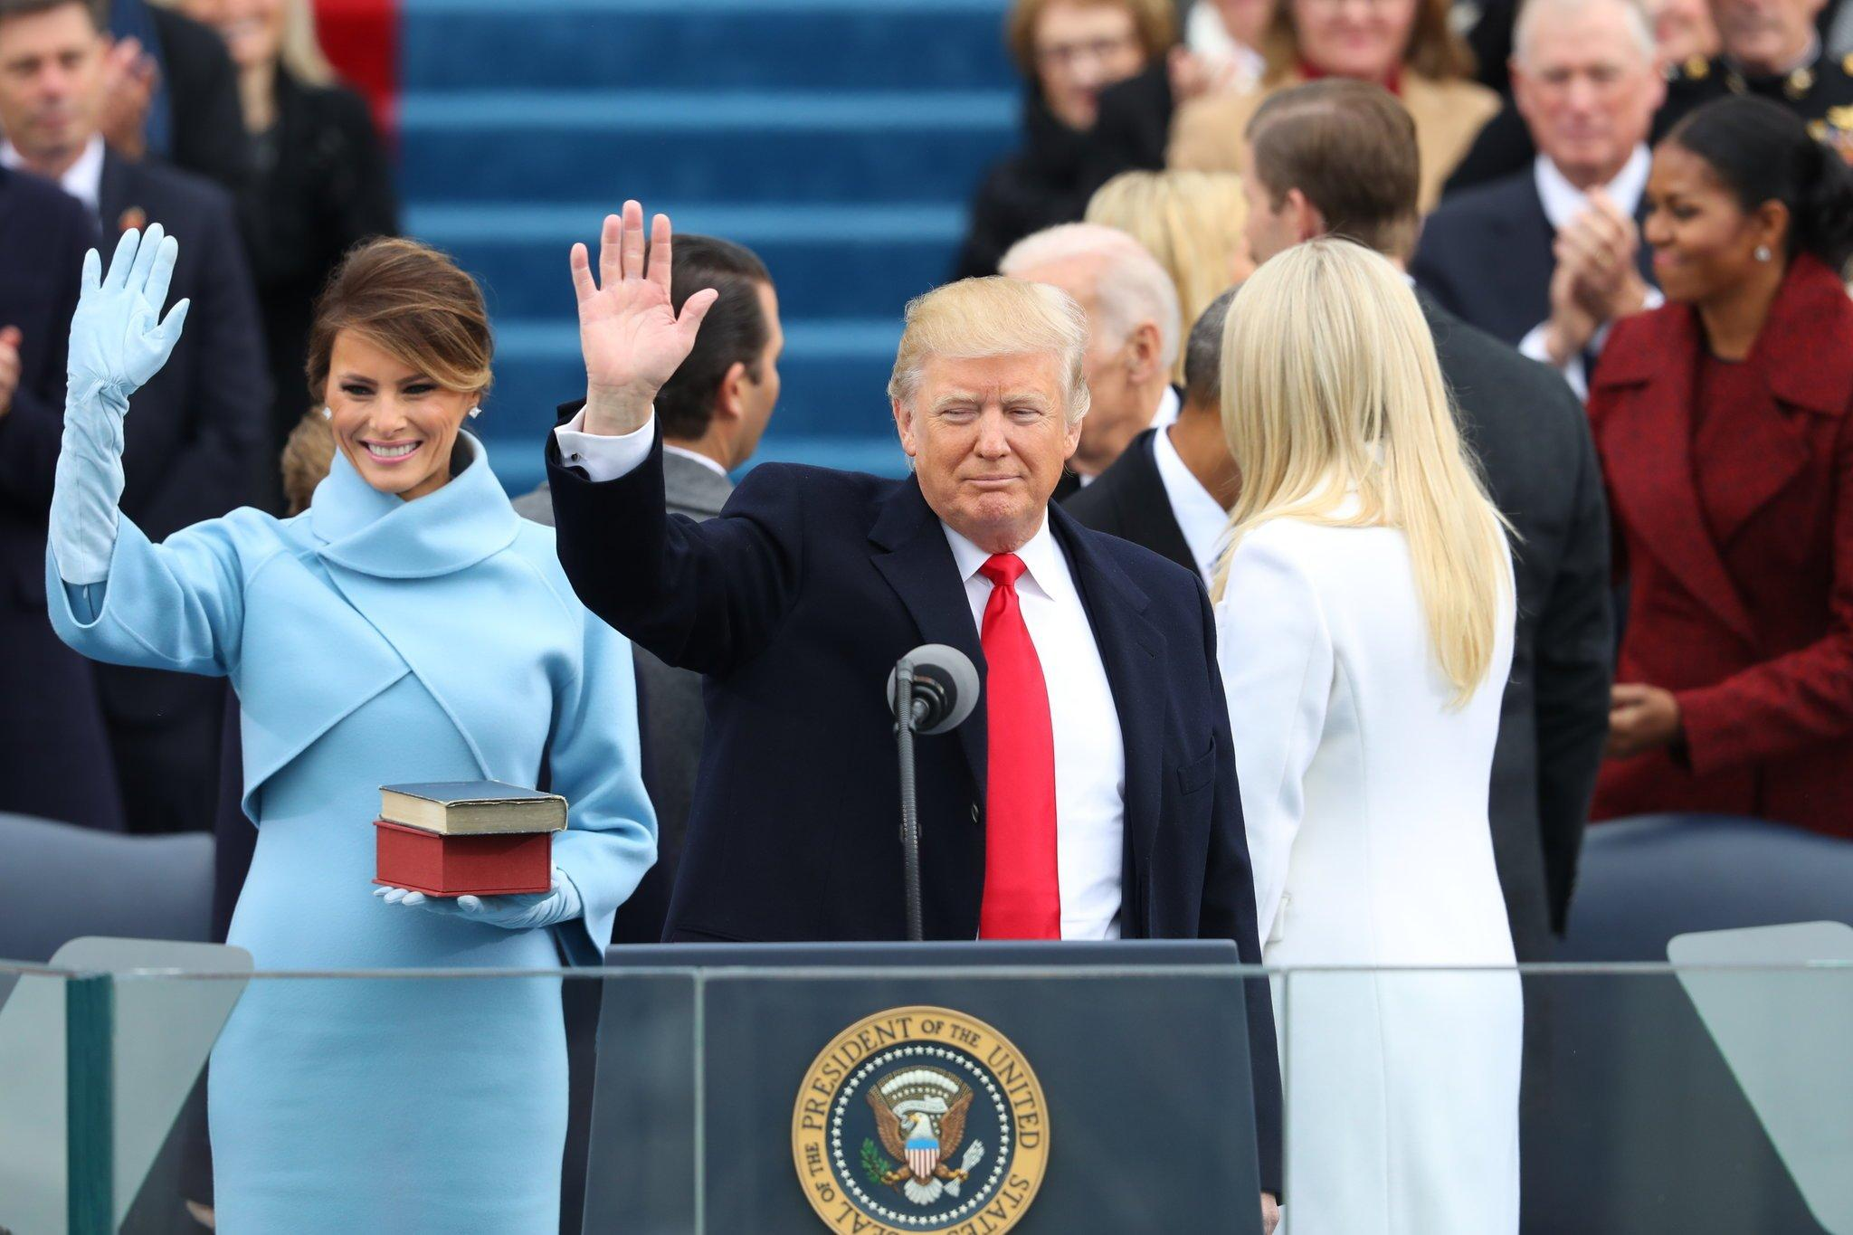
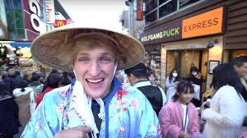
The Data
Sources and labelling mechanisms
Manually labeled comments: 2,633
OkGo’s “Obsession”
Trump Inauguration
Logan Paul in Japan
Taylor Swift
2018 Royal Wedding
Obtained pre-labeled data: 12,198
Twitter Dataset
Social Media Blogs
User Entered Video
Notes:
Matthew
-user entered video: we can take any url and create a dashboard with our sentiment analysis
-tried to pick videos of different kinds
-user entered: this is not just a one off, we can take any video and figure out the sentiment of the comments
-2633 manually labeled comments
-twitter data and social media blogs data inclusion to see if we could get better results outside of manually labeled YT data
Taylor Swift: I knew you were trouble
Royal wedding: Prince :

Slide 7
The Data
Sources and labelling mechanisms
Label | Comment
-1 | Everyone knows brands of papers, but no one knows about welfare
0 | Your paper cut balance is ...
1 | Made me smile. Great work
1 | Blowing my mind yet again
0 | Should have gone with Dunder Mifflin
1 | The mad methodical geniuses do it again
-1 | Waste of ink and paper
Notes:
Andie
Here is a glimpse of the data we labeled. Because our models take in numerical values, we mapped positive to the number 1, neutral to 0 and negative to -1.
We tried to remain objective in classifying the comments to prevent any possible bias.
For example, we labeled “Made me smile. Great Work” as positive with a 1.

Slide 8
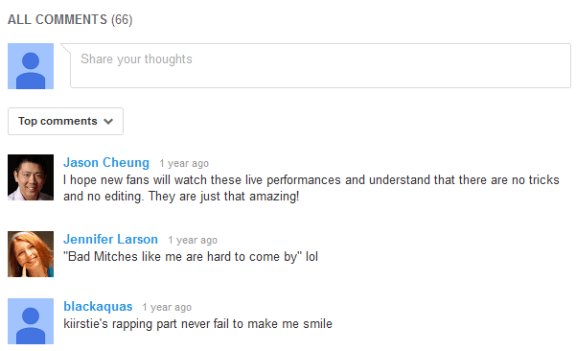

Data Collection
Pulling data out of Google’s YouTube API
YouTube API (Application Program Interface)
Real-time comments from videos
Notes:
Shon

Slide 9
Data Cleaning & NLP
Cleaning up the data and performing Natural Language Processing on texts
Removing non-alphanumeric characters (ex: %, &, *, $, #, @)
Natural Language Processing:
Removing stop words (ex: a, that, at, this)
Lemmatization
Stemming
Data Transformations
N-grams
TF-IDF
Notes:
Shon
TF-IDF filters out stop words on its own

Slide 10
Natural Language Processing
Teaching the computer how to process human language
Comments
Tokenizing
Lemmatization + Stemming
Transformations
I am really great at commenting on videos. Yep--that video was a great one!
Comments are cool!
I, am, really, great, at commenting, on, videos, yep, that, video, was, a, great, one
comments, are, cool
0.038, 0.075,
0.000, 0.075,
0.038, 0.075,
0.075, 0.038
0.000, 0.150
really, great, comment, video, yep, video,
great, one
comment, cool
Notes:
Shon
Tokenizing is breaking up comments into words in order to push them into our NLP steps and models
Lemmatization reduces words to their lemma (women → woman and better → good)
Stemming reducing words from inflected form to stem (working → work)
TF-IDF computes a weight which represents the importance of a term inside a document
*** Fix transformations
TF(t) = (Number of times term t appears in a document) / (Total number of terms in the document)
IDF(t) = log_e(Total number of documents / Number of documents with term t in it)

Slide 11
Models
Machine Learning models used in predicting classification outcomes
Models
Multinomial Naive Bayes Model *
Multinomial Logistic Regression *
Kth Nearest Neighbor
Linear Support Vector Machine
Random Forest
Gradient Boosting *
Randomized Grid Search
Hyperparameter Tuning
5 Fold Cross Validation
Model Validation
Notes:
Shon
Tuning hyperparameters is tuning on the parameters that are not set when the model is fit, allowing for a better performance on the task at hand
Cross Validation is used to assess the predictive performance of the models and and to judge how they perform outside the training data

Slide 12
Analysis of Results
Estimated accuracy of models and sentiment ratio results
Training and testing on YouTube data only:
 | MNB | LR | KNN | RF | GB
Accuracy | 0.64 | 0.65 | 0.43 | 0.58 | 0.62
Training on blog, twitter, & YouTube data and testing on YouTube Data:
 | MNB | LR | KNN | RF | GB
Accuracy | 0.58 | 0.53 | 0.45 | 0.57 | 0.56
Notes:
Andie
Using a mixture of training and testing techniques
Train on just youtube videos & test with youtube video
Train on all social media text data & test with youtube video
Test with one video or train and test with mixture
Precision: What proportion of positive identifications was actually correct?
Recall: What proportion of actual positives was identified correctly?
Using Twitter and blog data decreased the accuracy, precision, and recall of the models overall, so we ended up scrapping the twitter and social media data and just using YouTube data

Slide 13
Dashboard Demo
Using Dash to create interactive visualizations of results
Notes:
Andie
Relatively user- friendly application for content creators to examine the sentiment of comments on their videos
The word cloud shows a quick overview of what words and topics are being mentioned and how they play in to the ratios
Pie: ratio of sentiments present
What words are being used the most
Examine a few comments by eye
Application uses a user-entered video through the URL
Fix missing rows
Change models to top 3 w/ pickle files
Update number if necessary

Slide 14
Hurdles
Blockers in the project + troubleshooting
Manually classifying data
Comments in different languages
Emojis, spam, and misspellings
Sarcasm and long or mixed sentiment comments
Notes:
All
Shon: tried to label comments as objectively as possible
Andie: comments in different languages (russia, inauguration)
Matt: talk about emojis line - emojis = punctuation, some misspellings were fine, problematic misspellings were left in
Meaning of words, relationship of parts of words, structure of sentences, syntax in linguistics
Joke about different languages
Unique videos or videos with comments that need context
Need more data

Slide 15
Conclusions
Concluding remarks and recap of our findings
Able to classify comment sentiment with about 65% accuracy
Model performed better when training on just YouTube data
YouTube comments are a unique form of data and communication
Models had a difficult time predicting negative comments
Models had a relatively easier time predicting neutral comments
Some videos had comments that were very content-specific
Our models performed worse on these types of videos
Notes:
Andie start
Andie
Shon
Matthew

Slide 16
Future Work
Next steps in the project and NLP areas to look into
Vader, another way to do sentiment analysis
Compare video like-dislike ratio to ratio of comment sentiments
Analyze comment sentiment for videos over time
Ex: Election Debates before and after controversial event
Notes:
All
Matthew: vader
Shon: like/dislike ratio
Andie: sentiment changes over time
- Mention how like and dislike buttons represent sentiments in a different context
Our project is focused on the sentiments evoked by the video

Slide 17
Credits
Giving thanks for support, involvement, and resources
Data Science at UCSB
Conor O’Brien
Raul Eulogio (our troubleshooting guru)
Notes:
Shon

Slide 18
Thanks for Listening

Slide 19
Appendix
What the data looks like and statistical models

Slide 20



Shon Inouye
Andie Donovan
Matthew Peterschmidt

Slide 21
Conclusions
Concluding remarks and recap of our findings
Best Model for Training on YouTube Data
Multinomial Naive Bayes
Accuracy: 68%
Precision: 0.62, 0.67, 0.75
Recall: 0.48, 0.76, 0.71
Best Model for Training on Social Media and YouTube Data
Multinomial Logistic Regression
Accuracy: 67%
Precision: 0.50, 0.58, 0.86
Recall: 0.20, 0.84, 0.69
Notes:
Shon and Matthew
Models are more than twice as accurate as randomly guessing

Slide 22
Sources
Open source resources we used in this project
YouTube/ Google API
Two sources for outside datasets:
Sanders Analytics Twitter: https://github.com/zfz/twitter_corpus
Social Media Blogs: https://www.kaggle.com/c/si650winter11
Python, NLTK, Scikit-Learn software, packages, and documentation

